Slide 1
Mass Assembly
Ampli Kits

Slide 2
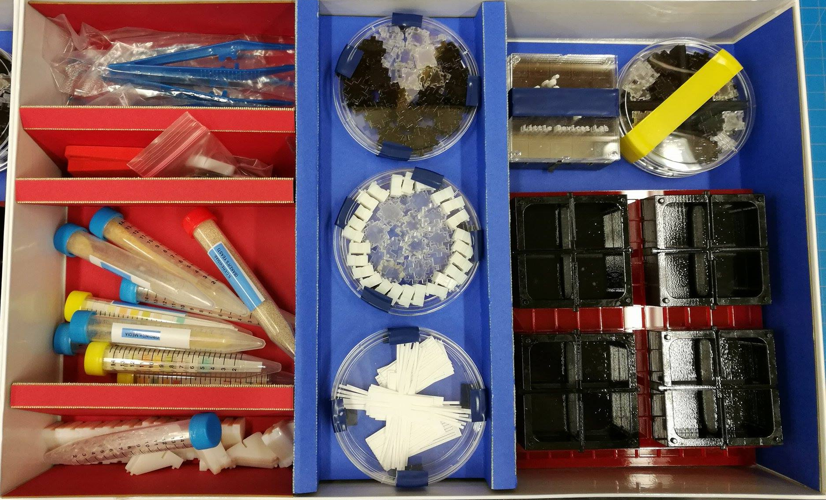
Classroom Kit Map
Droppers
Blank Black Blocks
Bioreactor Lids
Tweezers
Color Sensors
Unique Blocks
Vials
Bioreactors
Ramps
Bioreactor and Ramp Papers
Blank White Blocks
Grids

Slide 3
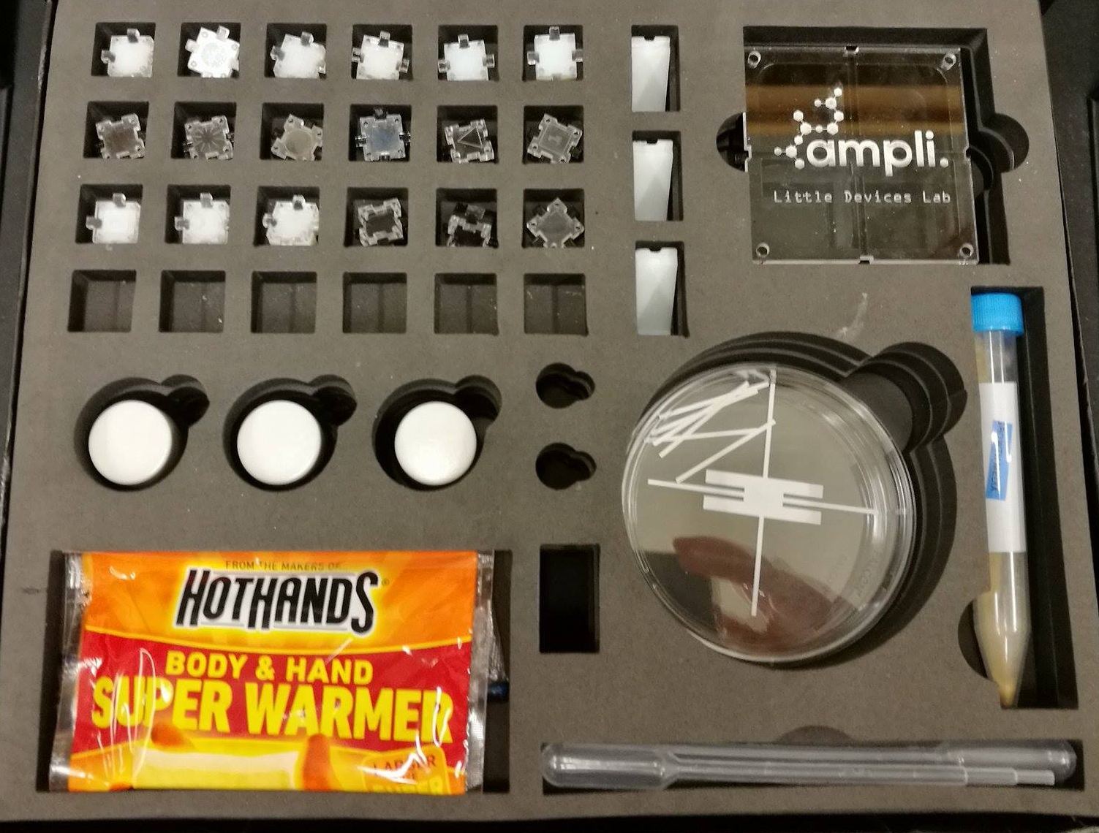
Teacher Kit Map
Blocks
Ramps
Glass Vials
Bioreactor Lids
Hand Warmers
Test Tube
???
Bioreactor and Ramp Papers
Droppers

Slide 4
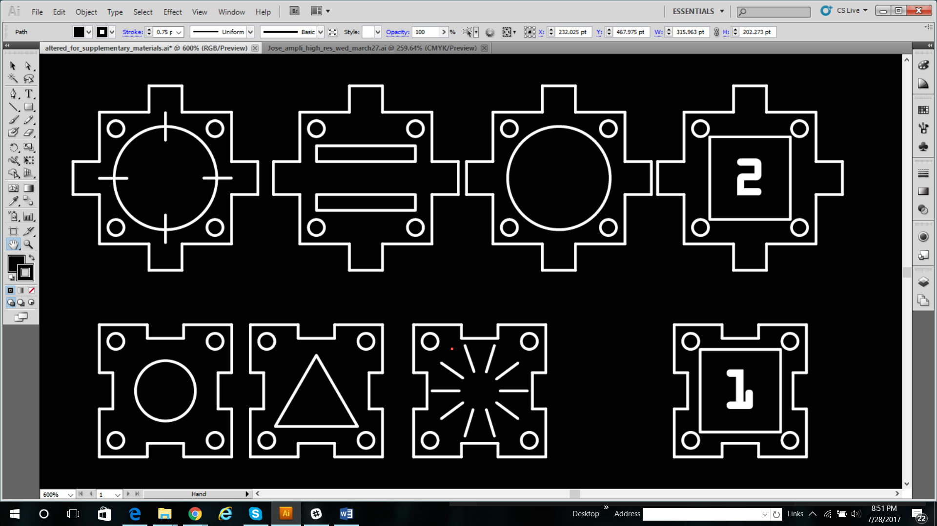
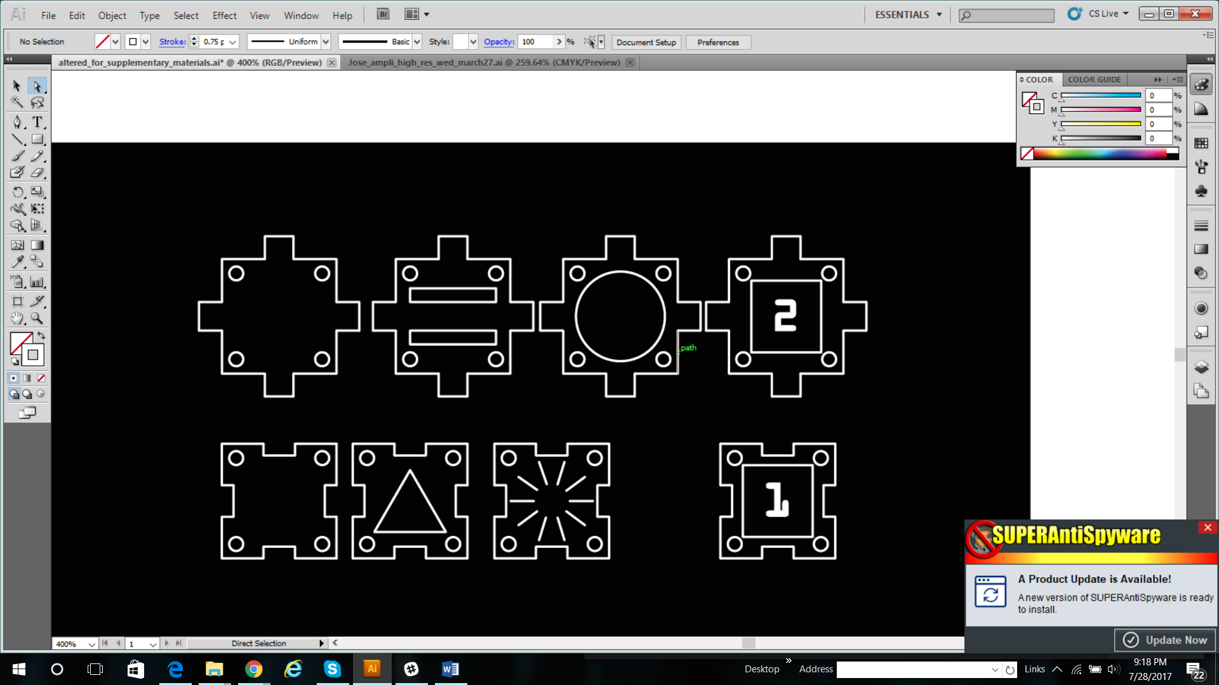
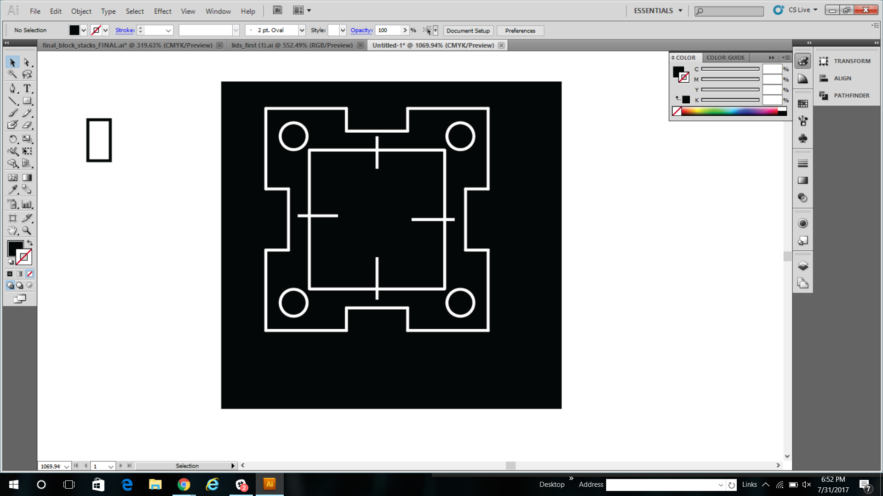
Legend of Lids
Blank: pipette block (hole
In the lid!!)
Prepare: adipic acid
Prespotted: PCC
Prepare: Salicylic Acid OR dilute strong acid (less than 5% in water)
Prepare: HMDA
Blank
Prepare: potassium permanganate
Blank
Blank
Blank
Prespotted: NP
Prepare: pH strip
Blank: color change

Slide 5
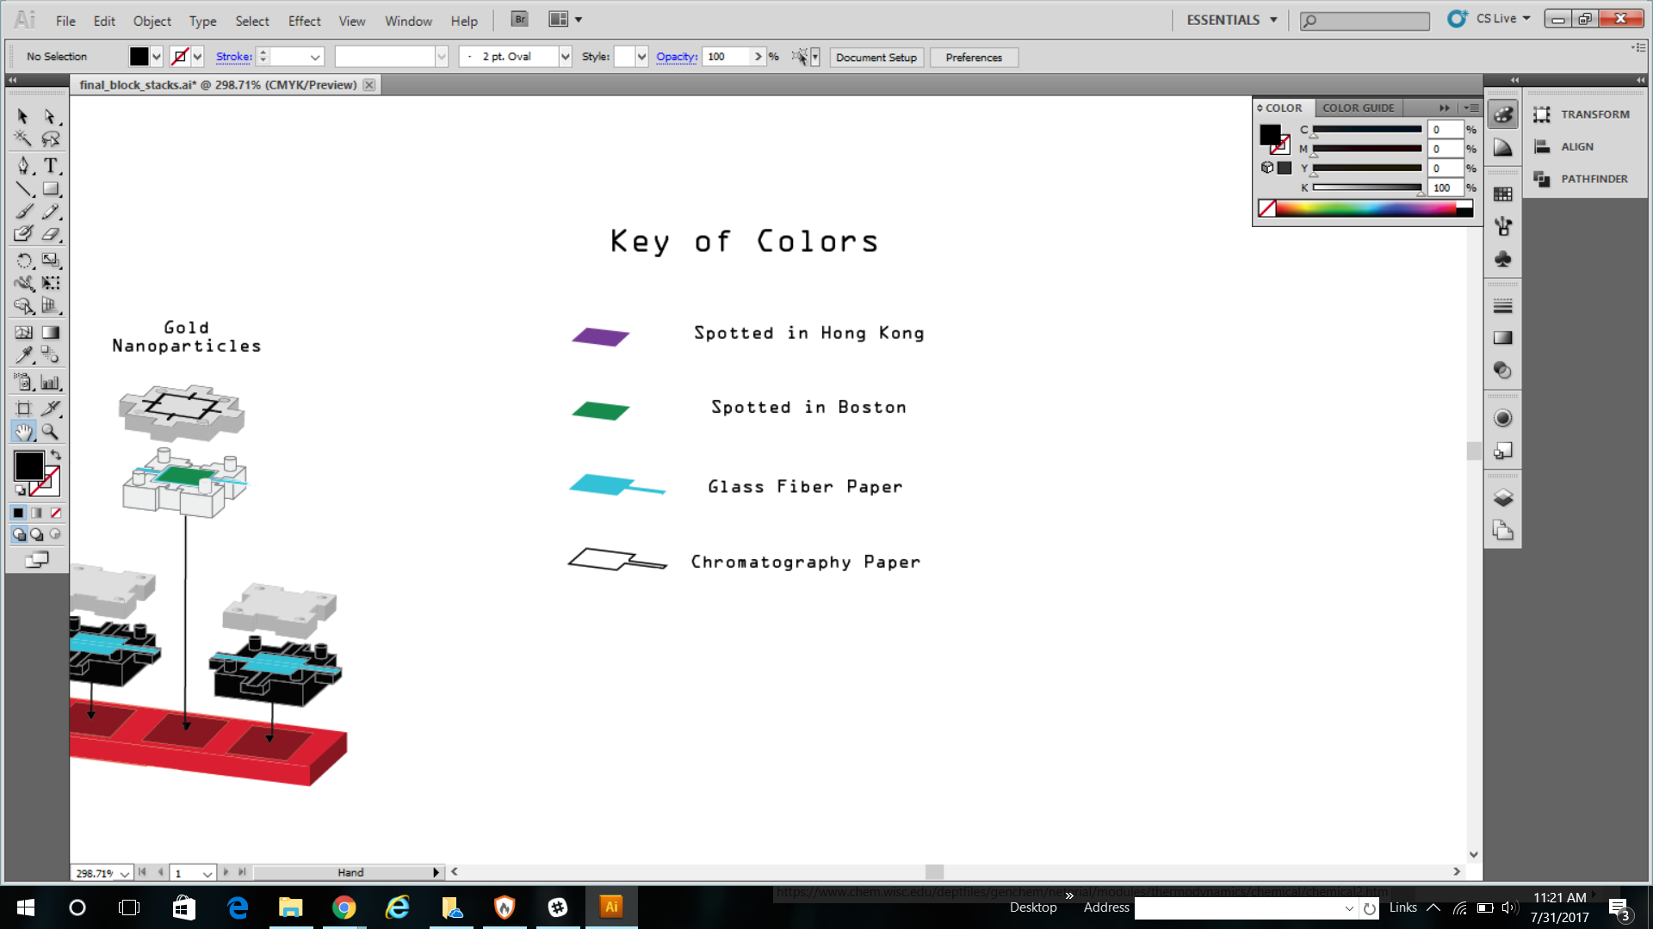
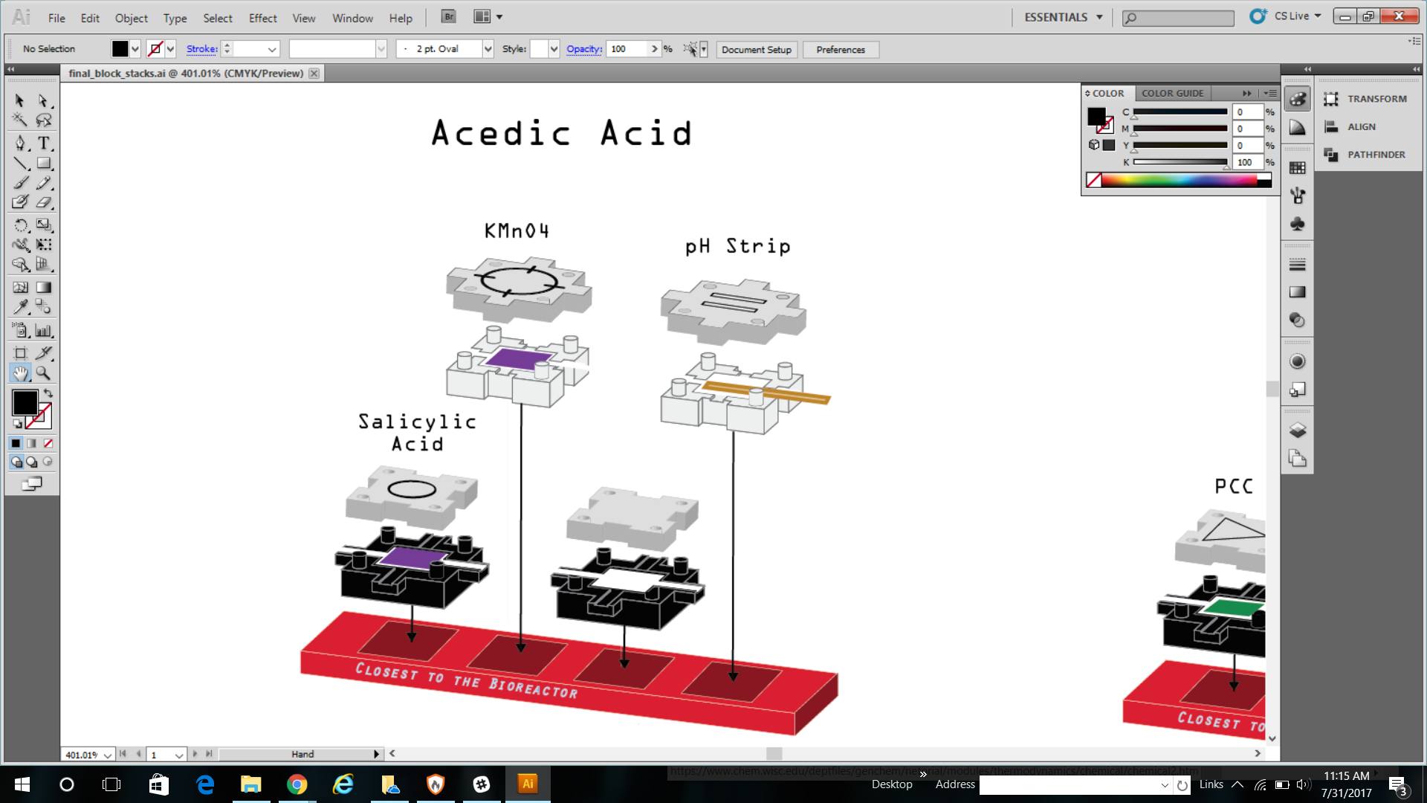
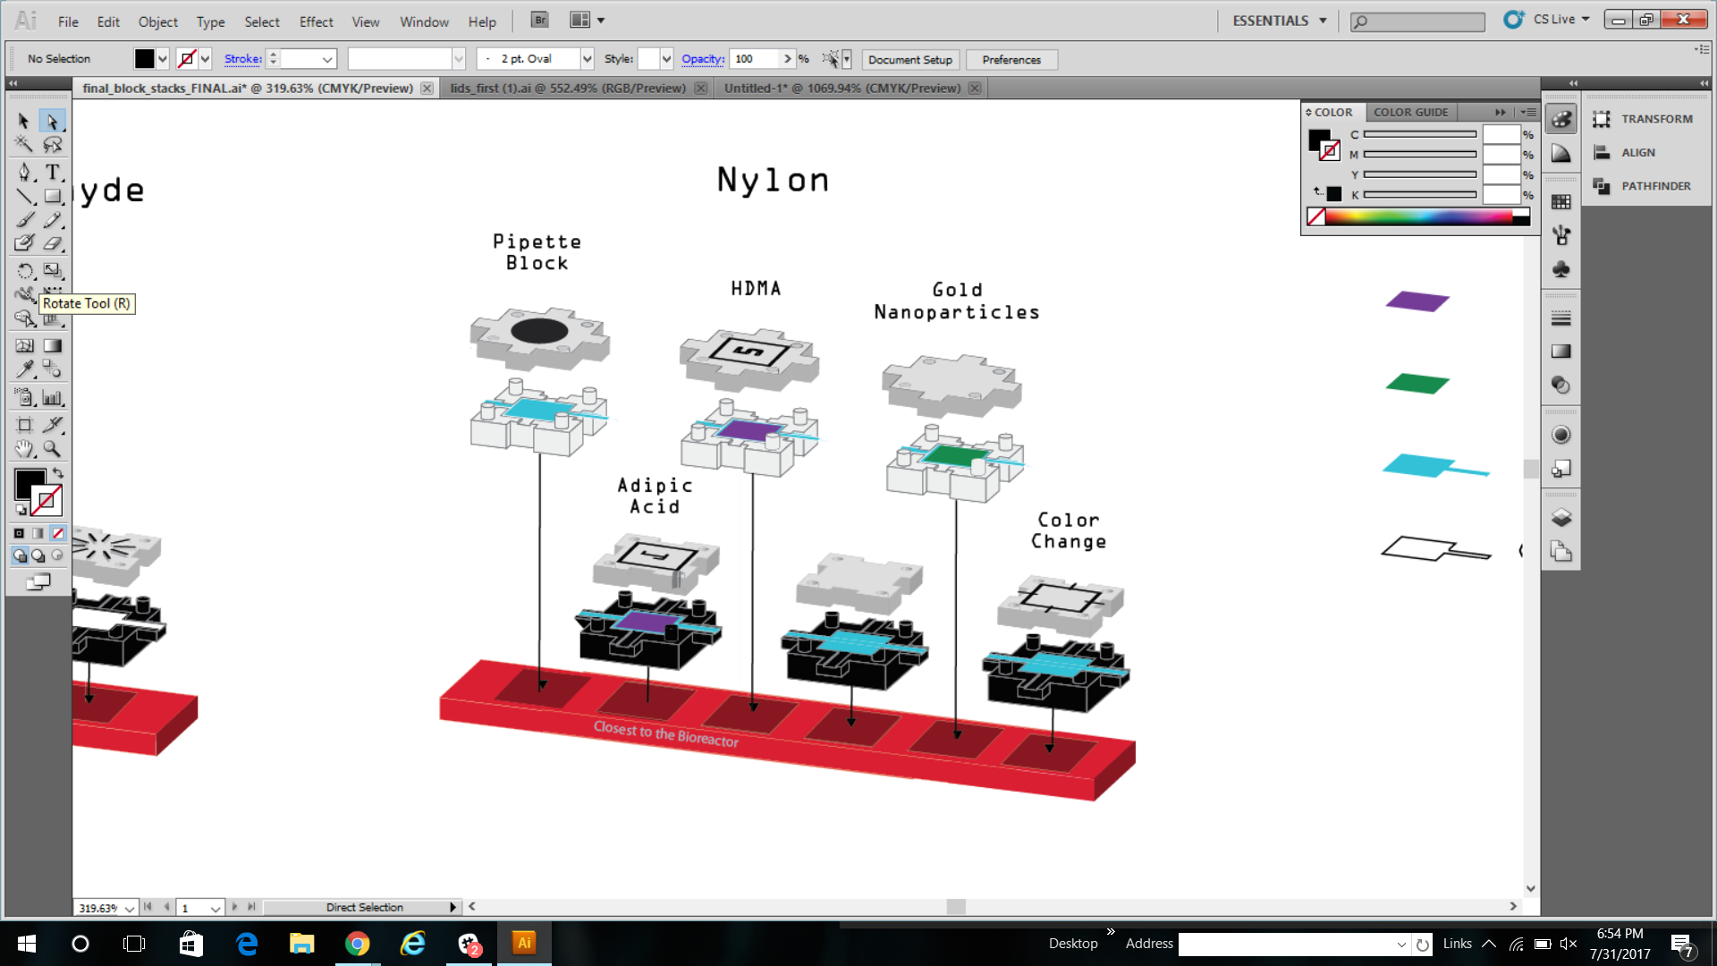
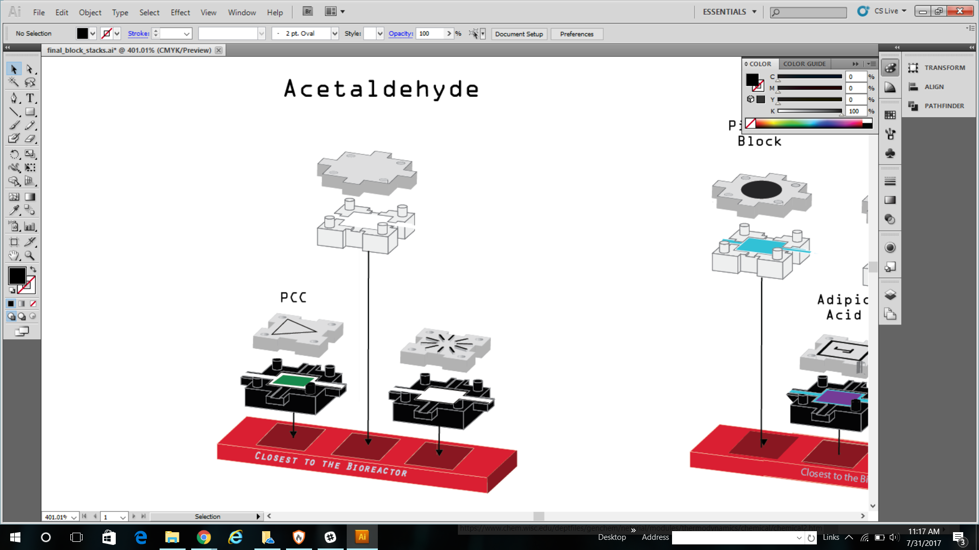
Legend of Lids

Slide 6
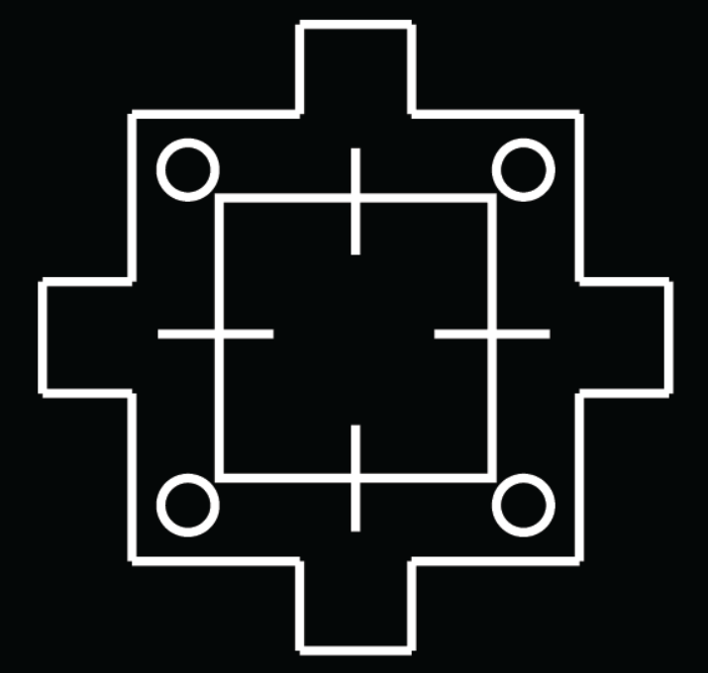
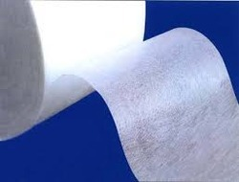

Glass Fiber vs. Chromatography Paper
HMDA, Adipic Acid, the Pipette Block, one black blank block, and this block
Should be done on glass fiber paper:
(Also known as the entire nylon reaction branch.)
The rest of the blocks should be done with regular
chromatography paper. It’s most of the paper and looks like this:

Slide 7
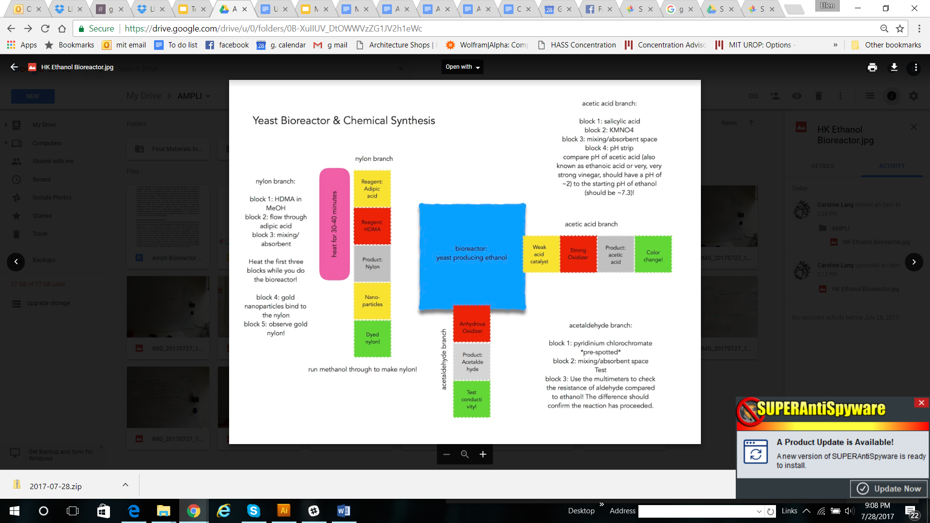
Legend of Reactions
White rectangles indicate white blocks
BioRea.

Slide 8
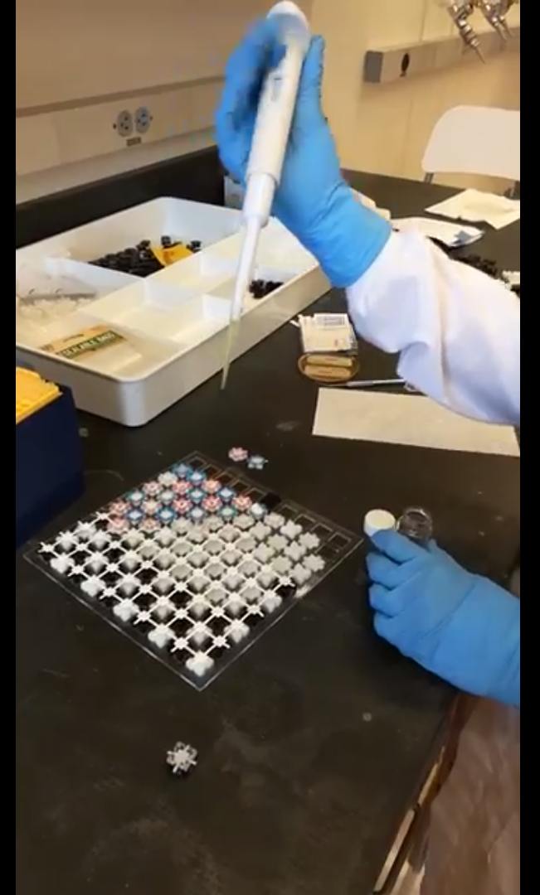
Videos
https://photos.app.goo.gl/QauwDOw8WKdGFHo13
The first video is of the mass assembly of the blocks
The second video is of spotting on an individual block
The third video is of spotting on the larger grid

Slide 9
Chemical Preparation
Adipic Acid: add 20mL of *methanol* (anhydrous or as close as possible). Spot 20uL on blocks (glass fiber paper) and let dry
HMDA: add 20mL of *methanol* (anhydrous or as close as possible). Spot 20uL on blocks (glass fiber paper) and let dry
Note! Adipic Acid and HMDA have a lot of volume, you may find it difficult to add a whole 20mL. If you can’t add that much, less is fine (I would recommend >=10mL though, to have it be somewhat dilute). Greater concentration is fine for the nylon synthesis. It’s also okay if not all the solid will dissolve, it may reach saturation which is a good thing.
KMNO4: add 20mL of water, preferably dH2O but any water will do. Spot 20uL on blocks (chromatography paper) and let dry
Salicylic Acid: Spot ~20uL on blocks (chromatography paper) and let dry
Note! You can put the lids on the blocks before they are dry. They’ll dry out over time anyway, regardless of whether the lid is on, and it doesn’t hurt to have it on.
Prespotted: (In the shiny silver packages)
Gold nanoparticles (Gold III chloride, HEPES): no prep required! Place in blocks. It’s fine if you can still see separate gold acid (yellow) and nanoparticles (purple), these will mix and form more when run in the reaction.
PCC: no prep required! Place in blocks.

Slide 10
Safety
Adipic Acid: mild irritant, mildly toxic, slightly flammable.
HMDA: corrosive, moderately toxic, tends to get white residue all over everything.
KMNO4: irritant, mildly toxic, strong oxidizer so may cause fires or explosions if mixed in sufficient quantity with organic or combustible material. May be explosive with sulfuric acid and metals. Don’t worry too much though, it’s dilute and there’s not very much of it! Maybe just don’t heat the vial or add things to it.
Salicylic Acid: essentially harmless, don’t drink it though, ingestion can produce transient hearing loss ...
Prespotted:
Gold nanoparticles (Gold III chloride, HEPES): gold iii chloride is corrosive and moderately toxic, but in nanoparticle form is probably significantly less problematic. It definitely doesn’t seem to be corrosive, though I haven’t tested extensively. I’d suggest gloves and not inhaling possible dust or fumes, but these blocks are not high on the list of concern.
PCC: extremely toxic, known carcinogen, strong oxidizer therefore may cause fires if mixed in sufficient quantity with organic or combustible material.
Bottom Line: You probably want a hood or respirator+goggles or stiff breeze for most of the chemicals except nanoparticles and salicylic acid? More so if you are doing a lot at once, 5-10 at once is much less problematic than spotting a whole set (can confirm). You definitely definitely want fume protection for PCC. The prespots are dry which helps a bit with fumes, though. Watch out for dust when adding water to the powder in the vials, however, and when handling the prespotted papers.

Slide 11
Things to get/prepare that aren’t chemicals:
Methanol (necessary for the nylon reaction and for preparing HMDA and adipic acid)
Ethanol (backup for the bioreactor if something doesn’t work quite as expected and it’s not good for synthesis)
Saran wrap or similar clingwrap to create an air-tight seal around the bioreactor during fermentation.
Table sugar or lab glucose for feeding the yeast.
Let us know if there are any issues with these, and we can look into options for substitution.

Slide 12
Bioreactor Setup & Inoculation
Bioreactor Initial Setup timeline:
Option 1. *ideal*
24 hours before class time, fill growth media tube with water (preferably sterile dH20 or bottled water, but tap water would also work). Shake until mixed, pour into bioreactor, and add about 2mL (height in the tube) of dry yeast to the bioreactor. Keep in a decently warm place (not near AC’s or in fridges, room temp is okay) for 8-12 hours.
12 hours or so before class time, take student bioreactors (or any that you want to undergo fermentation), add about a tablespoon of sugar (more -> faster fermentation, more ethanol, but don’t overdo the ratio because it can be overwhelming to the yeast). Close the lid and wrap the bioreactor with plastic wrap or parafilm so that it is mostly insulated from airflow -- oxygen deprivation drives fermentation.
Add sugar to the teacher bioreactor just before class time, if you would like a valid comparison with the fermented bioreactors.
Option 2. *if necessary*
At least 6-8 hours before class time, fill growth media tube with water (preferably sterile dH20 or bottled water, but tap water would also work). Shake until mixed, pour into bioreactor, and add about 2mL (height in the tube) of dry yeast to the bioreactor. Add about a tablespoon of sugar to the student bioreactors (or any you want to undergo fermentation), and wrap in plastic wrap to prevent airflow. Add sugar to the teacher bioreactor just before class time.
NOTE: Once you add sugar to the bioreactor, it may ferment. You theoretically should be able to prevent this by exposing the bioreactor to air, but it’s not guaranteed in my experience, so you might want to try adding sugar just to one teacher bioreactor per classroom per day, so there’s always a fresh one for students to compare to.

Slide 13
Setup Each Night before Class (1/2):
Pre-spot anything that hasn’t been prespotted (see previous instructions and key)
Clean up blocks. **Preferable to do this in a lab or classroom setting rather than in a hotel or living space, though if you are careful to avoid contamination and fumes you can probably figure out a way.
If not done by teachers: Remove old papers from blocks, and if possible (in a lab space), soak in water to dilute chemicals from blocks and lower risk of interaction with environment after disposal. Dispose of water and papers in an appropriate chemical disposal (*not* a regular sink, the water system isn’t designed to remove those kinds of chemicals during water treatment).
If you can’t soak the block papers or don’t have access to an appropriate chemical disposal, you can place like block papers together (e.g. PCC with PCC, KMNO4 with KMNO4) in ziplock freezer bags (thick plastic) and keep somewhere cool until you can access proper disposal.
The salicylic acid block alone is safe to dispose of in a regular trash. Yeast and media is also safe to dispose of in a regular trash or sink.
Place blocks themselves in a bottle or bowl, add dish soap or all-purpose cleaner, and (over a chemical-safe sink) run water into the container, allowing the blocks to slosh around (think homemade dishwasher). Hot/cold water doesn’t matter. If available, spraying the blocks down with ethanol or isopropanol spray will help to remove things that don’t remove easily with water. *Please note, the PCC blocks may not come clean, PCC leaves a very strong residue. Don’t worry too much about this, you can just use those blocks only for PCC.* It’s okay to mix blocks together for this wash step! There’s very little chemical on them and a lot of water.
Set blocks up for the next day with the same pattern of spots/lids.

Slide 14
Setup Each Night before Class (2/2):
IV. Check the bioreactors. The student bioreactors should be fermenting, so they should be wrapped with airtight plastic wrap. You may want to add an extra tablespoon of sugar every other day to keep the fermentation going (though not too often, as the yeast may not be able to keep up). If the bread smell starts to go away, definitely add some sugar, and consider pouring off some of the ethanol from the top of the bioreactor -- ethanol is bad for yeast, even though they make it. Any bioreactors that aren’t fermenting should have air. All should be in a relatively warm place to continue growth (no fridges or direct AC)

